Slide 1

“I have been trying to prove the following theorem: for any operators T,R the length of an arbitrary message f1 multiplied by its essential spectrum and divided by the distortion of the system is less than a certain constant times the time of transmission of F multiplied by its essential spectrum width or—roughly speaking—it is impossible to reduce bandwidth times transmission time for a given distortion.
This seems to be true although I do not have a general proof as yet.”
—Letter to Vannevar Bush,
February 16, 1939,
from Claude Shannon
Notes:
In this section, we introduce some concepts and terms that will be referred to
throughout the rest of the chapter and, indeed, throughout Part Two.

Slide 2
Transmission Terminology
Data transmission occurs between transmitter and receiver over some transmission medium
Communication is in the form of electromagnetic waves
Guided media
Twisted pair, coaxial cable, optical fiber
Unguided media (wireless)
Propagation through air, vacuum, and seawater
Notes:
Data transmission occurs between transmitter and receiver over some transmission
medium. Transmission media may be classified as guided or unguided. In both
cases, communication is in the form of electromagnetic waves. With guided media ,
the waves are guided along a physical path; examples of guided media are twisted
pair, coaxial cable, and optical fiber. Unguided media , also called wireless , provide
a means for transmitting electromagnetic waves but do not guide them; examples
are propagation through air, vacuum, and seawater.

Slide 3
Transmission Terminology
Direct link
Point-to-point
Multi-point
No intermediate devices other than amplifiers or repeaters used to increase signal strength
Direct link between two devices
Are the only 2 devices sharing medium
More than two devices share the same medium
Notes:
The term direct link is used to refer to the transmission path between two
devices in which signals propagate directly from transmitter to receiver with no
intermediate devices, other than amplifiers or repeaters used to increase signal
strength. Note that this term can apply to both guided and unguided media.
A guided transmission medium is point to point if it provides a direct link
between two devices and those are the only two devices sharing the medium. In a
multipoint guided configuration, more than two devices share the same medium.

Slide 4
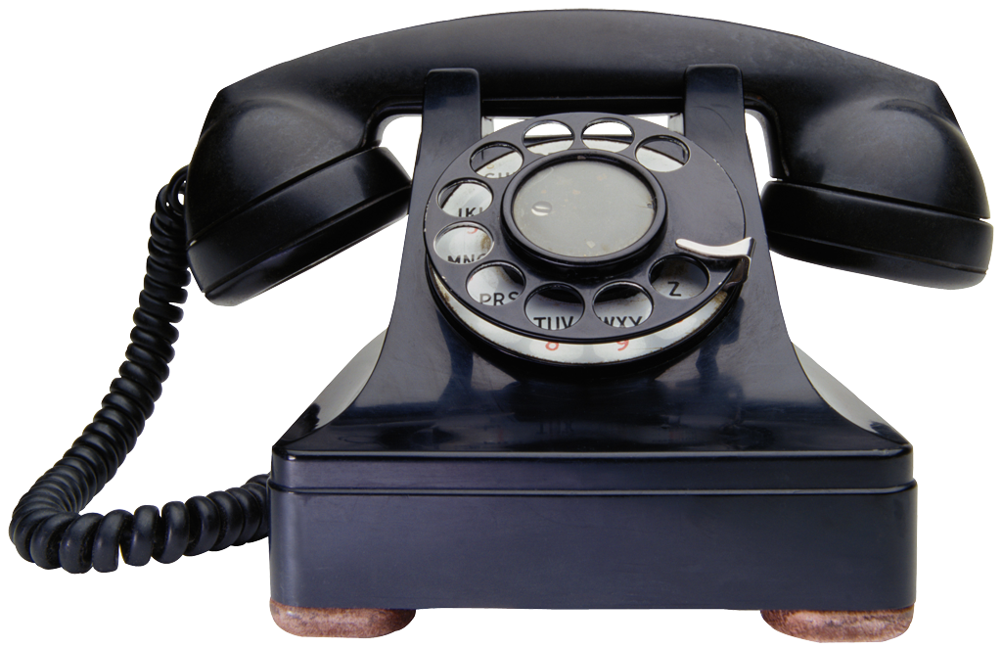
Transmission Terminology
Simplex
Signals are transmitted in only one direction
One station is transmitter and the other is receiver
Half duplex
Both stations transmit, but only one at a time
Full duplex
Both stations may transmit simultaneously
The medium is carrying signals in both directions at the same time
Notes:
A transmission may be simplex, half duplex , or full duplex . In simplex transmission,
signals are transmitted in only one direction; one station is transmitter and
the other is receiver. In half-duplex operation, both stations may transmit, but only
one at a time. In full-duplex operation, both stations may transmit simultaneously.
In the latter case, the medium is carrying signals in both directions at the same time.
We should note that the definitions just given are the ones in common use in the
United States (ANSI definitions). Elsewhere (ITU-T definitions), the term simplex
is used to correspond to half duplex , and duplex is used to correspond to full duplex
as just defined.

Slide 5
Notes:
Viewed as a function of time, an electromagnetic signal
can be either analog or digital. An analog signal is one in which the signal intensity
varies in a smooth, or continuous , fashion over time. In other words, there are no
breaks or discontinuities in the signal. A digital signal is one in which the signal
intensity maintains a constant level for some period of time and then abruptly
changes to another constant level, in a discrete fashion. Figure 3.1 shows an example
of each kind of signal. The analog signal might represent speech, and the digital
signal might represent binary 1s and 0s.

Slide 6
Notes:
The simplest sort of signal is a periodic signal , in which the same signal pattern
repeats over time. Figure 3.2 shows an example of a periodic continuous signal (sine
wave) and a periodic discrete signal (square wave).

Slide 7
Sine Wave
Is the fundamental periodic signal
Can be represented by three parameters
Peak amplitude (A)
Maximum value or strength of the signal over time
Typically measured in volts
Frequency (f)
Rate at which the signal repeats
Hertz (Hz) or cycles per second
Period (T) is the amount of time for one repetition
T = 1/f
Phase (φ)
Relative position in time within a single period of signal
Notes:
The sine wave is the fundamental periodic signal. A general sine wave can be
represented by three parameters: peak amplitude (A ), frequency (f ), and phase (φ ).
The peak amplitude is the maximum value or strength of the signal over time; typically,
this value is measured in volts. The frequency is the rate [in cycles per second,
or hertz (Hz)] at which the signal repeats. An equivalent parameter is the period
(T ) of a signal, which is the amount of time it takes for one repetition; therefore,
T = 1/f . Phase is a measure of the relative position in time within a single period of a
signal, as is illustrated subsequently.

Slide 8
Notes:
The general sine wave can be written
s(t) = A sin(2πft + f)
A function with the form of the preceding equation is known as a sinusoid. Figure 3.3 shows the effect of varying each of the three parameters. In part (a) of the figure, the frequency is 1 Hz; thus the period is T = 1 second. Part (b) has the same frequency and phase but a peak amplitude of 0.5. In part (c) we have f = 2, which is equivalent to T = 0.5. Finally, part (d) shows the effect of a phase shift of π/4 radians, which is 45 degrees (2π radians = 360˚ = 1 period).
In Figure 3.3, the horizontal axis is time; the graphs display the value of a signal at a given point in space as a function of time. These same graphs, with a change of scale, can apply with horizontal axes in space. In this case, the graphs display the value of a signal at a given point in time as a function of distance. For example, for a sinusoidal transmission (e.g., an electromagnetic radio wave some distance from a radio antenna, or sound some distance from a loudspeaker), at a particular instant of time, the intensity of the signal varies in a sinusoidal way as a function of distance from the source.

Slide 9
Wavelength (λ)
The wavelength of a signal is the distance occupied by a single cycle
Can also be stated as the distance between two points of corresponding phase of two consecutive cycles
Assuming signal velocity v, then the wavelength is related to the period as λ = vT
Or equivalently λf = v
Especially when v=c
c = 3*10⁸ m/s (speed of light in free space)
Notes:
There is a simple relationship between the two sine waves, one in time and one in space. The wavelength (λ) of a signal is the distance occupied by a single cycle, or, put another way, the distance between two points of corresponding phase of two consecutive cycles. Assume that the signal is traveling with a velocity v. Then the wavelength is related to the period as follows: l = vT. Equivalently, lf = v. Of particular relevance to this discussion is the case where v = c, the speed of light in free space, which is approximately 3 ´ 10⁸ m/s.

Slide 10
Frequency Domain Concepts
Signals are made up of many frequencies
Components are sine waves
Fourier analysis can show that any signal is made up of components at various frequencies, in which each component is a sinusoid
Can plot frequency domain functions
Notes:
In practice, an electromagnetic signal will be made up of many frequencies. For example, the signal
s(t) = [(4/π) × (sin(2πft) + (1/3) sin(2π(3f)t)]
is shown in Figure 3.4c. The components of this signal are just sine waves of frequencies f and 3f; parts (a) and (b) of the figure show these individual components. There are two interesting points that can be made about this figure:
The second frequency is an integer multiple of the first frequency. When all of the frequency components of a signal are integer multiples of one frequency, the latter frequency is referred to as the fundamental frequency. Each multiple of the fundamental frequency is referred to as a harmonic frequency of the signal.
The period of the total signal is equal to the period of the fundamental frequency. The period of the component sin (2πft) is T = 1/f, and the period of s(t) is also T, as can be seen from Figure 3.4c.
It can be shown, using a discipline known as Fourier analysis, that any signal is made up of components at various frequencies, in which each component is a sinusoid. By adding together enough sinusoidal signals, each with the appropriate amplitude, frequency, and phase, any electromagnetic signal can be constructed. Put another way, any electromagnetic signal can be shown to consist of a collection of periodic analog signals (sine waves) at different amplitudes, frequencies, and phases. The importance of being able to look at a signal from the frequency perspective (frequency domain) rather than a time perspective (time domain) should become clear as the discussion proceeds. For the interested reader, the subject of Fourier analysis is introduced in Appendix A.

Slide 11
Notes:
Figure 3.4c, the components of this signal are just sine waves of frequencies f and 3f, as shown in parts (a) and (b).

Slide 12
Notes:
So we can say that for each signal, there is a time domain function s(t) that specifies the amplitude of the signal at each instant in time. Similarly, there is a frequency domain function S(f) that specifies the peak amplitude of the constituent frequencies of the signal. Figure 3.5a shows the frequency domain function for the signal of Figure 3.4c. Note that, in this case, S(f) is discrete. Figure 3.5b shows the frequency domain function for a single square pulse that has the value 1 between –X/2 and X/2, and is 0 elsewhere. Note that in this case S(f) is continuous and that it has nonzero values indefinitely, although the magnitude of the frequency components rapidly shrinks for larger f. These characteristics are common for real signals.

Slide 13
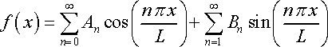
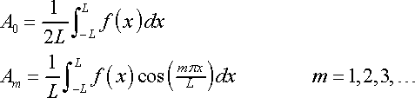
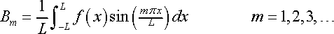
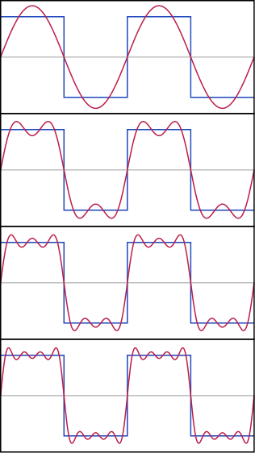
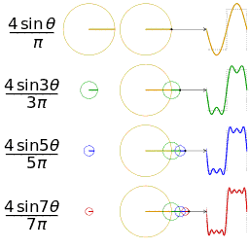
Fourier Series (nθ = n∏x/L), if x = time, L = 2T, T = Time period

Slide 14
Spectrum and Bandwidth
Spectrum
Range of frequencies contained in signal
Absolute bandwidth
Width of spectrum
Effective bandwidth (or just bandwidth)
Narrow band of frequencies containing most energy
Dc component
Component of zero frequency
Notes:
The spectrum of a signal is the range of frequencies that it contains. For the signal of Figure 3.4c, the spectrum extends from f to 3f. The absolute bandwidth of a signal is the width of the spectrum. In the case of Figure 3.4c, the bandwidth is 3f – f = 2f. Many signals, such as that of Figure 3.5b, have an infinite bandwidth. However, most of the energy in the signal is contained in a relatively narrow band of frequencies. This band is referred to as the effective bandwidth, or just bandwidth.
One final term to define is dc component. If a signal includes a component of zero frequency, that component is a direct current (dc) or constant component.

Slide 15
Notes:
Figure 3.6 shows the result of adding a dc component to the signal of Figure 3.4c. With no dc component, a signal has an average amplitude of zero, as seen in the time domain. With a dc component, it has a frequency term at f = 0 and a nonzero average amplitude.

Slide 16
Data Rate and Bandwidth
Any transmission system has a limited band of frequencies
This limits the data rate that can be carried on the transmission medium
Square waves have infinite components and hence an infinite bandwidth
Most energy in first few components
Limiting bandwidth creates distortions
There is a direct relationship between
data rate and bandwidth
Notes:
We have said that effective bandwidth is the band within which most of the signal energy is concentrated. The meaning of the term most in this context is somewhat arbitrary. The important issue here is that, although a given waveform may contain frequencies over a very broad range, as a practical matter any transmission system (transmitter plus medium plus receiver) will be able to accommodate only a limited band of frequencies. This, in turn, limits the data rate that can be carried on the transmission medium.
To try to explain these relationships, consider the square wave of Figure 3.2b. Suppose that we let a positive pulse represent binary 0 and a negative pulse represent binary 1. Then the waveform represents the binary stream 0101…. The duration of each pulse is 1/(2f); thus the data rate is 2f bits per second (bps). What are the frequency components of this signal? To answer this question, consider again Figure 3.4. By adding together sine waves at frequencies f and 3f, we get a waveform that begins to resemble the original square wave.

Slide 17
Notes:
Let us continue this process by adding a sine wave of frequency 5f, as shown in Figure 3.7a, and then adding a sine wave of frequency 7f, as shown in Figure 3.7b. As we add additional odd multiples of f, suitably scaled, the resulting waveform approaches that of a square wave more and more closely.
Thus, this waveform has an infinite number of frequency components and hence an infinite bandwidth. However, the peak amplitude of the kth frequency component, kf, is only 1/k, so most of the energy in this waveform is in the first few frequency components. What happens if we limit the bandwidth to just the first three frequency components? We have already seen the answer, in Figure 3.7a. As we can see, the shape of the resulting waveform is reasonably close to that of the original square wave.
We can draw the following conclusions from the preceding example. In general, any digital waveform will have infinite bandwidth. If we attempt to transmit this waveform as a signal over any medium, the transmission system will limit the bandwidth that can be transmitted. Furthermore, for any given medium, the greater the bandwidth transmitted, the greater the cost. Thus, on the one hand, economic and practical reasons dictate that digital information be approximated by a signal of limited bandwidth. On the other hand, limiting the bandwidth creates distortions, which makes the task of interpreting the received signal more difficult. The more limited the bandwidth, the greater the distortion, and the greater the potential for error by the receiver.

Slide 18
Analog and Digital Data Transmission
Data
Entities that convey information
Signals
Electric or electromagnetic representations of data
Signaling
Physical propagation of the signal along a suitable medium
Transmission
Communication of data by the propagation and processing of signals
Notes:
The terms analog and digital correspond, roughly, to continuous and discrete, respectively. These two terms are used frequently in data communications in at least three contexts: data, signaling, and transmission.
Briefly, we define data as entities that convey meaning, or information. Signals are electric or electromagnetic representations of data. Signaling is the physical propagation of the signal along a suitable medium. Transmission is the communication of data by the propagation and processing of signals. In what follows, we try to make these abstract concepts clear by discussing the terms analog and digital as applied to data, signals, and transmission.

Slide 19
Notes:
The most familiar example of analog data is audio, which, in the form of acoustic sound waves, can be perceived directly by human beings. Figure 3.9 shows the acoustic spectrum for human speech and for music. Frequency components of typical speech may be found between approximately 100 Hz and 7 kHz. Although much of the energy in speech is concentrated at the lower frequencies, tests have shown that frequencies below 600 or 700 Hz add very little to the intelligibility of speech to the human ear. Typical speech has a dynamic range of about 25 dB; that is, the power produced by the loudest shout may be as much as 300 times greater than the least whisper. Figure 3.9 also shows the acoustic spectrum and dynamic range for music.
Video transmission carries sequences of pictures in time. In essence, video
makes use of a sequence of raster-scan images. Here it is easier to characterize the
data in terms of the viewer’s (destination’s) television or computer display monitor
rather than the original scene (source) that is recorded by the video camera.
Video can be captured by either analog or digital video recorders. The video
that is captured can be transmitted using continuous (analog) or discrete (digital)
signals, can be received by either analog or digital display devices, and can be stored
in either analog or digital file formats.
The first televisions and computer monitors used cathode-ray-tube (CRT)
technology. CRT monitors are inherently analog devices that use an electron gun to
“paint” pictures on the screen. The gun emits an electron beam that scans across the
surface of the screen from left to right and top to bottom. For black-and-white television,
the amount of illumination produced (on a scale from black to white) at any
point is proportional to the intensity of the beam as it passes that point. Thus at any
instant in time the beam takes on an analog value of intensity to produce the desired
brightness at that point on the screen. Further, as the beam scans, the analog value
changes. Thus the video image can be thought of as a time-varying analog signal.
The term digital video refers to the capture, manipulation, and storage of
video in digital formats. Digital video cameras capture moving images digitally. In
essence, this is done by taking a series of digital photographs, at a rate of at least
30 frames per second.

Slide 20
Digital Data
Examples:
Text
Character strings
IRA
Notes:
A familiar example of digital data is text or character strings. While textual
data are most convenient for human beings, they cannot, in character form, be easily
stored or transmitted by data processing and communications systems. Such
systems are designed for binary data. Thus a number of codes have been devised
by which characters are represented by a sequence of bits. Perhaps the earliest
common example of this is the Morse code. Today, the most commonly used text
code is the International Reference Alphabet (IRA). Each character in this code
is represented by a unique 7-bit pattern; thus 128 different characters can be represented.
This is a larger number than is necessary, and some of the patterns represent
invisible control characters . IRA-encoded characters are almost always stored and
transmitted using 8 bits per character. The eighth bit is a parity bit used for error
detection. This bit is set such that the total number of binary 1s in each octet is
always odd (odd parity) or always even (even parity). Thus a transmission error that
changes a single bit, or any odd number of bits, can be detected.

Slide 21
Notes:
Figure 3.10 shows a sequence of voltage pulses, generated by a source using two
voltage levels, and the received voltage some distance down a conducting medium.
Because of the attenuation, or reduction, of signal strength at higher frequencies,
the pulses become rounded and smaller. It should be clear that this attenuation can
lead rather quickly to the loss of the information contained in the propagated signal.

Slide 22
Advantages and Disadvantages of Digital Signals
Generally cheaper
Less susceptible to noise interference
Suffer more from attenuation
Notes:
The principal advantages of digital signaling are that it is generally cheaper
than analog signaling and is less susceptible to noise interference. The principal disadvantage
is that digital signals suffer more from attenuation than do analog signals.

Slide 23
Notes:
Let us return to the three examples in the preceding subsection. For
each example, we will describe the signal and estimate its bandwidth.
First, we consider audio , or acoustic, information. One form of acoustic information,
of course, is human speech. This form of information is easily converted to
an electromagnetic signal for transmission (Figure 3.11). In essence, all of the sound
frequencies, whose amplitude is measured in terms of loudness, are converted into
electromagnetic frequencies, whose amplitude is measured in volts. The telephone
handset contains a simple mechanism for making such a conversion.
In the case of acoustic data (voice), the data can be represented directly by
an electromagnetic signal occupying the same spectrum. However, there is a need
to compromise between the fidelity of the sound as transmitted electrically and the
cost of transmission, which increases with increasing bandwidth. As mentioned, the
spectrum of speech is approximately 100 Hz to 7 kHz, although a much narrower
bandwidth will produce acceptable voice reproduction. The standard spectrum
for a voice channel is 300 to 3400 Hz. This is adequate for speech transmission,
minimizes required transmission capacity, and allows the use of rather inexpensive
telephone sets. The telephone transmitter converts the incoming acoustic voice
signal into an electromagnetic signal over the range 300 to 3400 Hz. This signal is
then transmitted through the telephone system to a receiver, which reproduces it
as acoustic sound.

Slide 24
Video Signals
To produce a video signal a TV camera is used
USA standard is 483 lines per frame, at a rate of 30 complete frames per second
Actual standard is 525 lines but about 42 are lost during vertical retrace
Horizontal scanning frequency is 525 lines x 30 scans = 15750 lines per second
Max frequency if line alternates between black and white as rapidly as possible
Notes:
Now let us look at the video signal. To produce a video signal, a TV camera, which performs similar functions to the TV receiver, is used. One component of the camera is a photosensitive plate, upon which a scene is optically focused. An electron beam sweeps across the plate from left to right and top to bottom, in the same fashion as depicted in Figure 3.10 for the receiver. As the beam sweeps, an analog electric signal is developed proportional to the brightness of the scene at a particular spot. We mentioned that a total of 483 lines are scanned at a rate of 30 complete scans per second. This is an approximate number taking into account the time lost during the vertical retrace interval. The actual U.S. standard is 525 lines, but of these about 42 are lost during vertical retrace. Thus the horizontal scanning frequency is (525 lines) × (30 scan/s) = 15,750 lines per second, or 63.5 µs/line. Of the 63.5 µs, about 11 µs are allowed for horizontal retrace, leaving a total of 52.5 µs per video line.
Now we are in a position to estimate the bandwidth required for the video signal. To do this we must estimate the upper (maximum) and lower (minimum) frequency of the band. We use the following reasoning to arrive at the maximum frequency: The maximum frequency would occur during the horizontal scan if the scene were alternating between black and white as rapidly as possible. We can estimate this maximum value by considering the resolution of the video image. In the vertical dimension, there are 483 lines, so the maximum vertical resolution would be 483. Experiments have shown that the actual subjective resolution is about 70% of that number, or about 338 lines. In the interest of a balanced picture, the horizontal and vertical resolutions should be about the same. Because the ratio of width to height of a TV screen is 4 : 3, the horizontal resolution should be about 4/3 ´ 338 = 450 lines. As a worst case, a scanning line would be made up of 450 elements alternating black and white. The scan would result in a wave, with each cycle of the wave consisting of one higher (black) and one lower (white) voltage level. Thus there would be 450/2 = 225 cycles of the wave in 52.5 µs, for a maximum frequency of about 4.2 MHz. This rough reasoning, in fact, is fairly accurate. The lower limit is a dc or zero frequency, where the dc component corresponds to the average illumination of the scene (the average value by which the brightness exceeds the reference black level). Thus the bandwidth of the video signal is approximately 4 MHz – 0 = 4 MHz.

Slide 25
Notes:
Finally, the third example described is the general case of binary data . Binary
data is generated by terminals, computers, and other data processing equipment
and then converted into digital voltage pulses for transmission, as illustrated in
Figure 3.12. A commonly used signal for such data uses two constant (dc) voltage
levels: one level for binary 1 and one level for binary 0. (In Chapter 5, we shall see
that this is but one alternative, referred to as nonreturn to zero (NRZ).) Again, we
are interested in the bandwidth of such a signal. This will depend, in any specific
case, on the exact shape of the waveform and the sequence of 1s and 0s. We can
obtain some understanding by considering Figure 3.8 (compare with Figure 3.7). As
can be seen, the greater the bandwidth of the signal, the more faithfully it approximates
a digital pulse stream.

Slide 26
Notes:
In the foregoing discussion, we have looked at analog signals,
used to represent analog data, and digital signals, used to represent digital
data. Generally, analog data are a function of time and occupy a limited frequency
spectrum; such data can be represented by an electromagnetic signal occupying the
same spectrum. Digital data can be represented by digital signals, with a different
voltage level for each of the two binary digits.
As Figure 3.13 illustrates, these are not the only possibilities. Digital data can
also be represented by analog signals by use of a modem (modulator/demodulator).
The modem converts a series of binary (two-valued) voltage pulses into an
analog signal by encoding the digital data onto a carrier frequency. The resulting
signal occupies a certain spectrum of frequency centered about the carrier and
may be propagated across a medium suitable for that carrier. The most common
modems represent digital data in the voice spectrum and hence allow those data to
be propagated over ordinary voice-grade telephone lines. At the other end of the
line, another modem demodulates the signal to recover the original data.
In an operation very similar to that performed by a modem, analog data can
be represented by digital signals. The device that performs this function for voice
data is a codec (coder-decoder). In essence, the codec takes an analog signal that
directly represents the voice data and approximates that signal by a bit stream. At
the receiving end, the bit stream is used to reconstruct the analog data.
Thus, Figure 3.13 suggests that data may be encoded into signals in a variety of
ways. We return to this topic in Chapter 5.

Slide 27
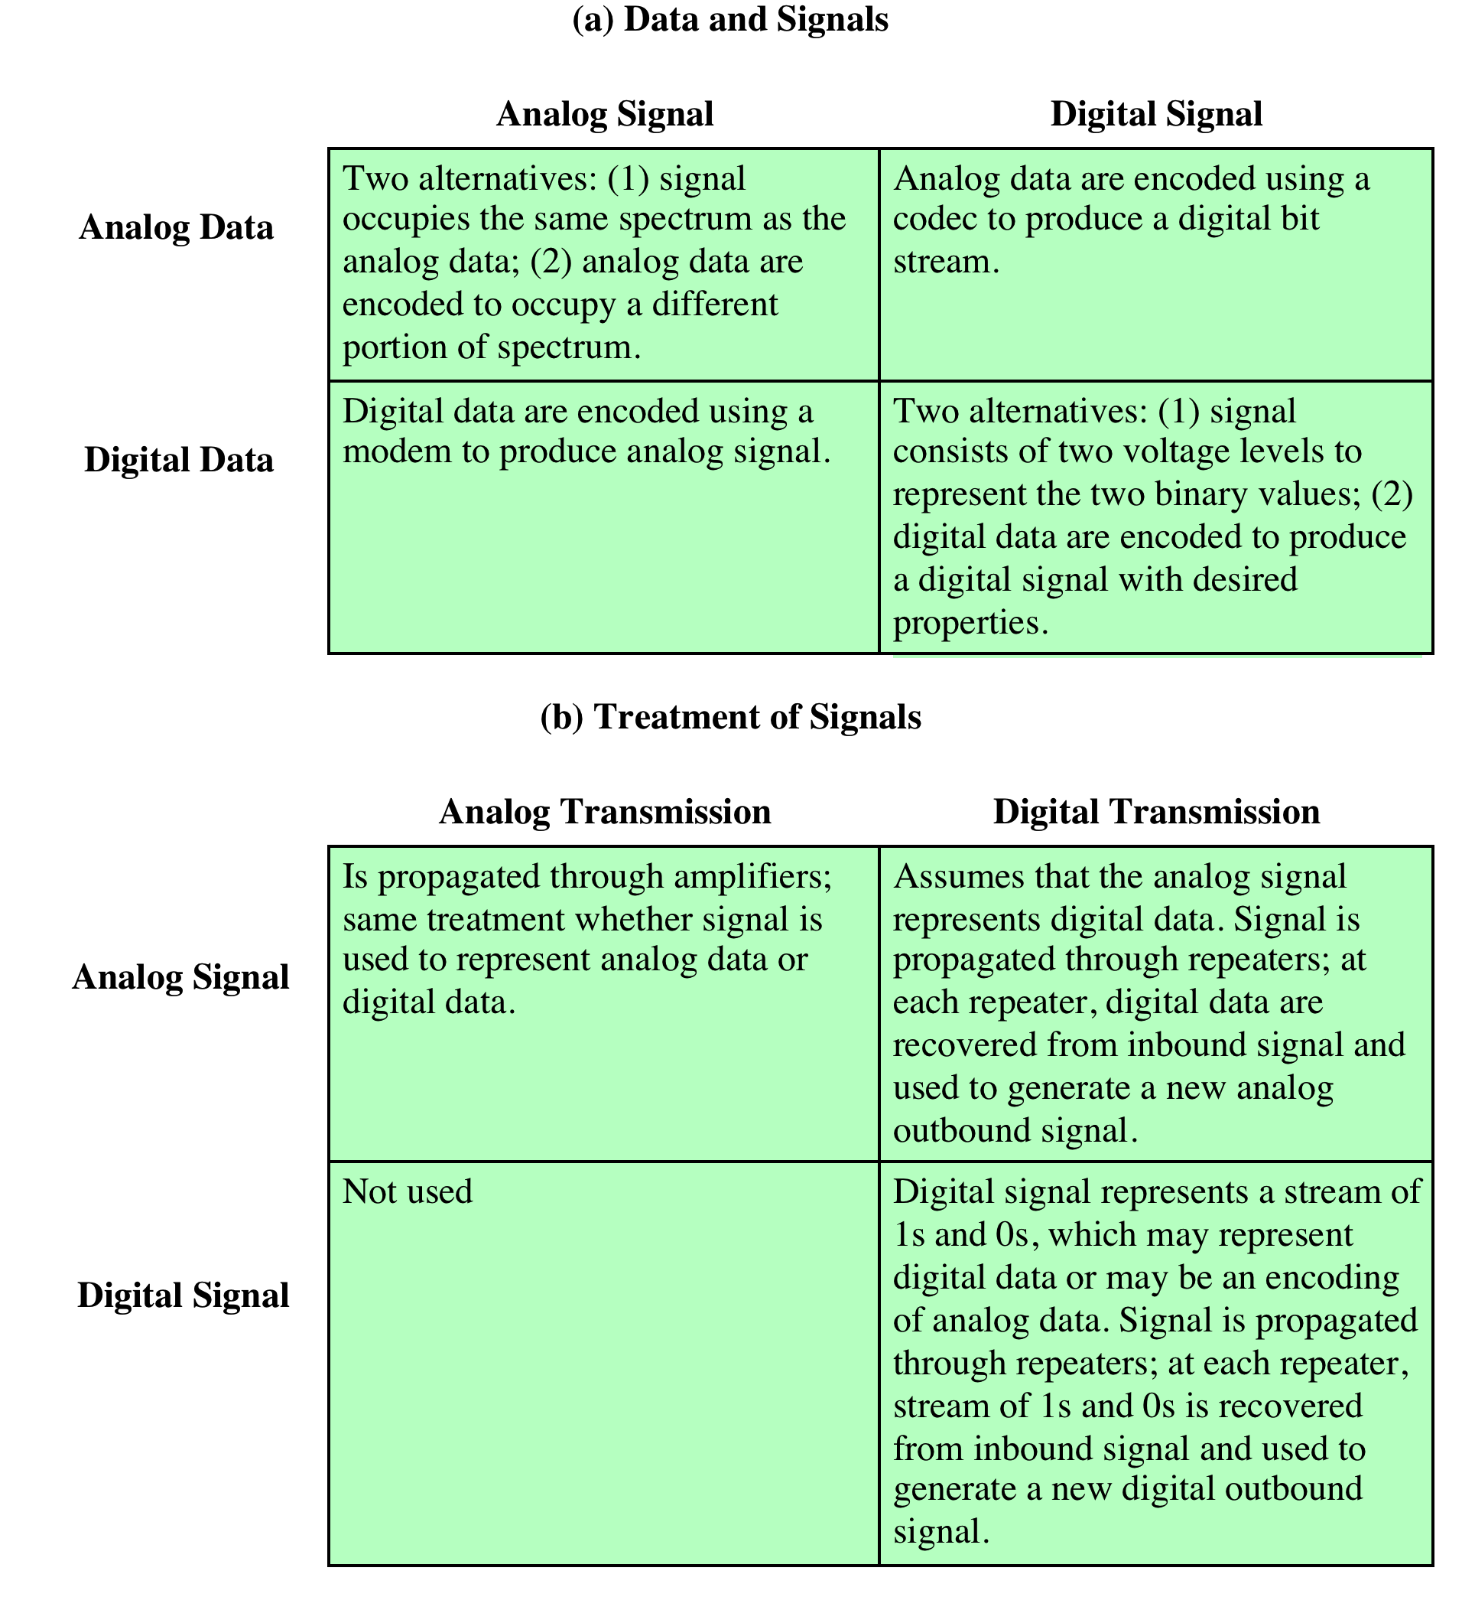
Table 3.1 Analog and Digital Transmission
Notes:
Both analog and digital signals may be transmitted on suitable transmission media.
The way these signals are treated is a function of the transmission system. Table 3.1
summarizes the methods of data transmission. Analog transmission is a means of
transmitting analog signals without regard to their content; the signals may represent
analog data (e.g., voice) or digital data (e.g., binary data that pass through
a modem). In either case, the analog signal will become weaker (attenuate) after
a certain distance. To achieve longer distances, the analog transmission system
includes amplifiers that boost the energy in the signal. Unfortunately, the amplifier
also boosts the noise components. With amplifiers cascaded to achieve long distances,
the signal becomes more and more distorted. For analog data, such as voice,
quite a bit of distortion can be tolerated and the data remain intelligible. However,
for digital data, cascaded amplifiers will introduce errors.
Digital transmission , by contrast, assumes a binary content to the signal.
A digital signal can be transmitted only to a limited distance before attenuation,
noise, and other impairments endanger the integrity of the data. To achieve greater
distances,
repeaters are used. A repeater receives the digital signal, recovers the
pattern of 1s and 0s, and retransmits a new signal. Thus the attenuation is overcome.
The same technique may be used with an analog signal if it is assumed that
the signal carries digital data. At appropriately spaced points, the transmission system
has repeaters rather than amplifiers. The repeater recovers the digital data
from the analog signal and generates a new, clean analog signal. Thus noise is not
cumulative.

Slide 28
Move to Digital
Digital technology
LSI and VLSI technology has caused a continuing drop in the cost and size of digital circuitry
Data integrity
The use of repeaters has made it possible to transmit data longer distances over lower quality lines while maintaining the integrity of the data
Capacity utilization
It has become economical to build transmission links of very high bandwidth, including satellite channels and optical fiber, and a high degree of multiplexing is needed to utilize such capacity effectively
Security and privacy
Encryption techniques can be readily applied to digital data and to analog data that have been digitized
Integration
Economies of scale and convenience can be achieved by integrating voice, video, and digital data
Notes:
The question naturally arises as to which is the preferred method of transmission.
The answer being supplied by the telecommunications industry and its customers
is digital. Both long-haul telecommunications facilities and intrabuilding
services have moved to digital transmission and, where possible, digital signaling
techniques. The most important reasons are the following:
• Digital technology: The advent of large-scale integration (LSI) and very-largescale
integration (VLSI) technology has caused a continuing drop in the cost
and size of digital circuitry. Analog equipment has not shown a similar drop.
• Data integrity: With the use of repeaters rather than amplifiers, the effects of
noise and other signal impairments are not cumulative. Thus, it is possible to
transmit data longer distances and over lower quality lines by digital means
while maintaining the integrity of the data.
• Capacity utilization: It has become economical to build transmission links of
very high bandwidth, including satellite channels and optical fiber. A high
degree of multiplexing is needed to utilize such capacity effectively, and this
is more easily and cheaply achieved with digital (time division) rather than
analog (frequency division) techniques. This is explored in Chapter 8.
• Security and privacy: Encryption techniques can be readily applied to digital
data and to analog data that have been digitized.
• Integration: By treating both analog and digital data digitally, all signals have
the same form and can be treated similarly. Thus economies of scale and convenience
can be achieved by integrating voice, video, and digital data.

Slide 29
Asynchronous and Synchronous Transmission
Asynchronous
Strategy is to avoid the timing problem by not sending long, uninterrupted streams of bits
Data are transmitted one character at a time, where each character is 5 to 8 bits in length
Timing or synchronization must only be maintained within each character
The receiver has the opportunity to resynchronize at the beginning of each new character
Synchronous
A block of bits is transmitted in a steady stream without start and stop codes
Block may be many bits in length
To prevent timing drift between transmitter and receiver, their clocks must somehow be synchronized
Provide a separate clock line between transmitter and receiver
Embed the clocking information in the data signal
Frame
Data plus preamble, postamble, and control information
Notes:
The reception of digital data involves sampling the incoming signal once per bit
time to determine the binary value. One of the difficulties encountered in such a
process is that various transmission impairments will corrupt the signal so that occasional
errors will occur. This problem is compounded by a timing difficulty: In order
for the receiver to sample the incoming bits properly, it must know the arrival time
and duration of each bit that it receives.
Two approaches are common for achieving the desired synchronization. The
first is called, oddly enough, asynchronous transmission . The strategy with this
scheme is to avoid the timing problem by not sending long, uninterrupted streams
of bits. Instead, data are transmitted one character at a time, where each character
is 5 to 8 bits in length. Timing or synchronization must only be maintained within
each character; the receiver has the opportunity to resynchronize at the beginning
of each new character.
With synchronous transmission, a block of bits is transmitted in a steady
stream without start and stop codes. The block may be many bits in length. To prevent
timing drift between transmitter and receiver, their clocks must somehow be
synchronized. One possibility is to provide a separate clock line between transmitter
and receiver. One side (transmitter or receiver) pulses the line regularly with
one short pulse per bit time. The other side uses these regular pulses as a clock.
This technique works well over short distances, but over longer distances the clock
pulses are subject to the same impairments as the data signal, and timing errors
can occur. The other alternative is to embed the clocking information in the data
signal. For digital signals, this can be accomplished with Manchester or differential
Manchester encoding. For analog signals, a number of techniques can be used; for
example, the carrier frequency itself can be used to synchronize the receiver based
on the phase of the carrier.
With synchronous transmission, there is another level of synchronization
required to allow the receiver to determine the beginning and end of a block of
data. To achieve this, each block begins with a preamble bit pattern and generally
ends with a postamble bit pattern. In addition, other bits are added to the block that
conveys control information used in the data link control procedures. The data plus
preamble, postamble, and control information are called a frame . The exact format
of the frame depends on which data link control procedure is being used.

Slide 30
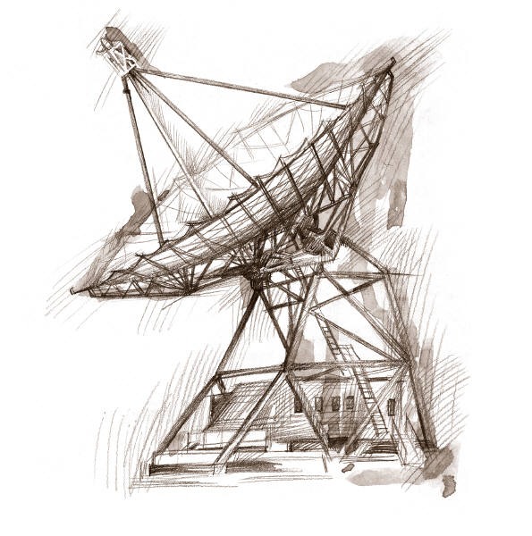
Transmission Impairments
Signal received may differ from signal transmitted causing:
Analog - degradation of signal quality
Digital - bit errors
Most significant impairments are
Attenuation and attenuation distortion
Delay distortion
Noise
Notes:
With any communications system, the signal that is received may differ from the
signal that is transmitted, due to various transmission impairments. For analog signals,
these impairments introduce various random modifications that degrade the
signal quality. For digital signals, bit errors may be introduced, such that a binary 1
is transformed into a binary 0 or vice versa. In this section, we examine the various
impairments and how they may affect the information-carrying capacity of a communication
link; Chapter 5 looks at measures that can be taken to compensate for
these impairments.
The most significant impairments are
• Attenuation and attenuation distortion
• Delay distortion
• Noise

Slide 31
ATTENUATION
Received signal strength must be:
Strong enough to be detected
Sufficiently higher than noise to be received without error
Strength can be increased using amplifiers or repeaters
Equalize attenuation across the band of frequencies used by using loading coils or amplifiers
Signal strength falls off with distance over any transmission medium
Varies with frequency
Notes:
Attenuation
The strength of a signal falls off with distance over any transmission medium. For guided media (e.g., twisted-pair wire, optical fiber), this reduction in strength, or attenuation, is generally exponential and thus is typically expressed as a constant number of decibels per unit distance. For unguided media (wireless transmission), attenuation is a more complex function of distance and the makeup of the atmosphere. Attenuation introduces three considerations for the transmission engineer.
1. A received signal must have sufficient strength so that the electronic circuitry in the receiver can detect and interpret the signal.
2. The signal must maintain a level sufficiently higher than noise to be received without error.
3. Attenuation is greater at higher frequencies, and this causes distortion.
The first and second considerations are dealt with by attention to signal strength and the use of amplifiers or repeaters. For a point-to-point link, the signal strength of the transmitter must be strong enough to be received intelligibly, but not so strong as to overload the circuitry of the transmitter or receiver, which would cause distortion. Beyond a certain distance, the attenuation becomes unacceptably great, and repeaters or amplifiers are used to boost the signal at regular intervals. These problems are more complex for multipoint lines where the distance from transmitter to receiver is variable.
The third consideration, known as attenuation distortion, is particularly noticeable for analog signals. Because attenuation is different for different frequencies, and the signal is made up of a number of components at different frequencies, the received signal is not only reduced in strength but is also distorted. To overcome this problem, techniques are available for equalizing attenuation across a band of frequencies. This is commonly done for voice-grade telephone lines by using loading coils that change the electrical properties of the line; the result is to smooth out attenuation effects. Another approach is to use amplifiers that amplify high frequencies more than lower frequencies.

Slide 32
Notes:
An example is provided in Figure 3.14a, which shows attenuation as a function
of frequency for a typical leased line.
The solid line in Figure 3.14a shows attenuation without equalization. As can
be seen, frequency components at the upper end of the voice band are attenuated
much more than those at lower frequencies. It should be clear that this will result
in a distortion of the received speech signal. The dashed line shows the effect of
equalization. The flattened response curve improves the quality of voice signals. It
also allows higher data rates to be used for digital data that are passed through a
modem.
Attenuation distortion can present less of a problem with digital signals.
As we have seen, the strength of a digital signal falls off rapidly with frequency
(Figure 3.5b); most of the content is concentrated near the fundamental frequency
or bit rate of the signal.

Slide 33
Delay Distortion
Occurs in transmission cables such as twisted pair, coaxial cable, and optical fiber
Does not occur when signals are transmitted through the air by means of antennas
Occurs because propagation velocity of a signal through a guided medium varies with frequency
Various frequency components arrive at different times resulting in phase shifts between the frequencies
Particularly critical for digital data since parts of one bit spill over into others causing intersymbol interference
Notes:
Delay distortion is a phenomenon that occurs in transmission cables (such as twisted
pair, coaxial cable, and optical fiber); it does not occur when signals are transmitted
through the air by means of antennas. Delay distortion is caused by the fact that the
velocity of propagation of a signal through a cable is different for different frequencies.
For a signal with a given bandwidth, the velocity tends to be highest near the
center frequency of the signal and to fall off toward the two edges of the band. Thus,
various components of a signal will arrive at the receiver at different times.
This effect is referred to as delay distortion because the received signal is
distorted due to varying delays experienced at its constituent frequencies. Delay
distortion is particularly critical for digital data. Consider that a sequence of bits is
being transmitted, using either analog or digital signals. Because of delay distortion,
some of the signal components of 1 bit position will spill over into other bit positions,
causing intersymbol interference , which is a major limitation to maximum bit
rate over a transmission channel.
Equalizing techniques can also be used for delay distortion. Again using a
leased telephone line as an example, Figure 3.14b shows the effect of equalization
on delay as a function of frequency.

Slide 34
Noise
Unwanted signals inserted between transmitter and receiver
Is the major limiting factor in communications system performance
Notes:
For any data transmission event, the received signal will consist of the transmitted
signal, modified by the various distortions imposed by the transmission system, plus
additional unwanted signals that are inserted somewhere between transmission and
reception. The latter, undesired signals are referred to as noise . Noise is the major
limiting factor in communications system performance.
Noise may be divided into four categories:
• Thermal noise
• Intermodulation noise
• Crosstalk
• Impulse noise

Slide 35
Categories of Noise
Thermal noise
Due to thermal agitation of electrons
Uniformly distributed across bandwidths
Referred to as white noise
Intermodulation noise
Produced by nonlinearities in the transmitter, receiver, and/or intervening transmission medium
Effect is to produce signals at a frequency that is the sum or difference of the two original frequencies
Notes:
Thermal noise is due to thermal agitation of electrons. It is present in all electronic
devices and transmission media and is a function of temperature. Thermal
noise is uniformly distributed across the bandwidths typically used in communications
systems and hence is often referred to as white noise. Thermal noise cannot
be eliminated and therefore places an upper bound on communications system performance.
Because of the weakness of the signal received by satellite earth stations,
thermal noise is particularly significant for satellite communication.
When signals at different frequencies share the same transmission medium,
the result may be intermodulation noise . The effect of intermodulation noise is
to produce signals at a frequency that is the sum or difference of the two original
frequencies or multiples of those frequencies. For example, if two signals, one
at 4000 Hz and one at 8000 Hz, share the same transmission facility, they might
produce energy at 12,000 Hz. This noise could interfere with an intended signal at
12,000 Hz.
Intermodulation noise is produced by nonlinearities in the transmitter,
receiver, and/or intervening transmission medium. Ideally, these components
behave as linear systems; that is, the output is equal to the input times a constant.
However, in any real system, the output is a more complex function of the input.
Excessive nonlinearity can be caused by component malfunction or overload from
excessive signal strength. It is under these circumstances that the sum and difference
frequency terms occur.

Slide 36
Categories of Noise
Crosstalk:
A signal from one line is picked up by another
Can occur by electrical coupling between nearby twisted pairs or when microwave antennas pick up unwanted signals
Impulse Noise:
Caused by external electromagnetic interferences
Noncontinuous, consisting of irregular pulses or spikes
Short duration and high amplitude
Minor annoyance for analog signals but a major source of error in digital data
Notes:
Crosstalk has been experienced by anyone who, while using the telephone,
has been able to hear another conversation; it is an unwanted coupling between
signal paths. It can occur by electrical coupling between nearby twisted pairs or,
rarely, coax cable lines carrying multiple signals. Crosstalk can also occur when
microwave antennas pick up unwanted signals; although highly directional antennas
are used, microwave energy does spread during propagation. Typically, crosstalk is
of the same order of magnitude as, or less than, thermal noise.
All of the types of noise discussed so far have reasonably predictable and relatively
constant magnitudes. Thus it is possible to engineer a transmission system to
cope with them. Impulse noise, however, is noncontinuous, consisting of irregular
pulses or noise spikes of short duration and of relatively high amplitude. It is generated
from a variety of causes, including external electromagnetic disturbances, such
as lightning, and faults and flaws in the communications system.

Slide 37
Channel Capacity
Maximum rate at which data can be transmitted over a given communications channel under given conditions
Data rate
The rate, in bits per second (bps) at which data can be communicated
Bandwidth
The bandwidth of the transmitted signal as constrained by the transmitter and the nature of the transmission medium, expressed in cycles per second, or hertz
Error rate
The rate at which errors occur, where an error is the reception of a 1 when a 0 was transmitted or the reception of a 0 when a 1 was transmitted
The greater the bandwidth of a facility, the greater the cost
The main constraint on achieving efficiency is noise
Noise
The average level of noise over the communications path
Notes:
We have seen that there are a variety of impairments that distort or corrupt a signal.
For digital data, the question that then arises is to what extent these impairments
limit the data rate that can be achieved. The maximum rate at which data can be
transmitted over a given communication path, or channel, under given conditions, is
referred to as the channel capacity .
There are four concepts here that we are trying to relate to one another.
• Data rate: The rate, in bits per second (bps), at which data can be communicated
• Bandwidth: The bandwidth of the transmitted signal as constrained by the
transmitter and the nature of the transmission medium, expressed in cycles
per second, or hertz
• Noise: The average level of noise over the communications path
• Error rate: The rate at which errors occur, where an error is the reception of a
1 when a 0 was transmitted or the reception of a 0 when a 1 was transmitted
The problem we are addressing is this: Communications facilities are expensive,
and, in general, the greater the bandwidth of a facility, the greater the cost.
Furthermore, all transmission channels of any practical interest are of limited bandwidth.
The limitations arise from the physical properties of the transmission medium
or from deliberate limitations at the transmitter on the bandwidth to prevent interference
from other sources. Accordingly, we would like to make as efficient use as
possible of a given bandwidth. For digital data, this means that we would like to get
as high a data rate as possible at a particular limit of error rate for a given bandwidth.
The main constraint on achieving this efficiency is noise.

Slide 38
Nyquist Bandwidth
In the case of a channel that is noise free:
The limitation of data rate is simply the bandwidth of the signal
If the rate of signal transmission is 2B then a signal with frequencies no greater than B is sufficient to carry the signal rate
Given a bandwidth of B, the highest signal rate that can be carried is 2B
For binary signals, the data rate that can be supported by B Hz is 2B bps
With multilevel signaling, the Nyquist formula becomes: C = 2B log₂M
Data rate can be increased by increasing the number of different signal elements
This increases burden on receiver
Noise and other impairments limit the practical value of M
Notes:
To begin, let us consider the case of a channel that is noise free. In this environment, the limitation on data rate is simply the bandwidth of the signal. A formulation of this limitation, due to Nyquist, states that if the rate of signal transmission is 2B, then a signal with frequencies no greater than B is sufficient to carry the signal rate. The converse is also true: Given a bandwidth of B, the highest signal rate that can be carried is 2B. This limitation is due to the effect of intersymbol interference, such as is produced by delay distortion. The result is useful in the development of digital-to-analog encoding schemes and is, in essence, based on the same derivation as that of the sampling theorem, described in Appendix G.
Note that in the preceding paragraph, we referred to signal rate. If the signals to be transmitted are binary (two voltage levels), then the data rate that can be supported by B Hz is 2B bps. However, as we shall see in Chapter 5, signals with more than two levels can be used; that is, each signal element can represent more than one bit. For example, if four possible voltage levels are used as signals, then each signal element can represent two bits. With multilevel signaling, the Nyquist formulation becomes
C = 2B log₂ M
where M is the number of discrete signal or voltage levels.
So, for a given bandwidth, the data rate can be increased by increasing the number of different signal elements. However, this places an increased burden on the receiver: Instead of distinguishing one of two possible signal elements during each signal time, it must distinguish one of M possible signal elements. Noise and other impairments on the transmission line will limit the practical value of M.

Slide 39
Shannon Capacity Formula
Considering the relation of data rate, noise and error rate:
Faster data rate shortens each bit so bursts of noise corrupts more bits
Given noise level, higher rates mean higher errors
Shannon developed formula relating these to signal to noise ratio (in decibels)
SNR_{db}⁼10 log₁₀ (signal/noise)
Capacity C = B log₂(1+SNR)
Theoretical maximum capacity
Get much lower rates in practice
Notes:
Nyquist's formula indicates that, all other things being equal, doubling the bandwidth doubles the data rate. Now consider the relationship among data rate, noise, and error rate. The presence of noise can corrupt one or more bits. If the data rate is increased, then the bits become "shorter" so that more bits are affected by a given pattern of noise.
Figure 3.15 illustrates this relationship. If the data rate is increased, then more bits will occur during the interval of a noise spike, and hence more errors will occur.
All of these concepts can be tied together neatly in a formula developed by the mathematician Claude Shannon. As we have just illustrated, the higher the data rate, the more damage that unwanted noise can do. For a given level of noise, we would expect that a greater signal strength would improve the ability to receive data correctly in the presence of noise. The key parameter involved in this reasoning is the signal-to-noise ratio (SNR, or S/N), which is the ratio of the power in a signal to the power contained in the noise that is present at a particular point in the transmission. Typically, this ratio is measured at a receiver, because it is at this point that an attempt is made to process the signal and recover the data. For convenience, this ratio is often reported in decibels:
The signal-to-noise ratio is important in the transmission of digital data because it sets the upper bound on the achievable data rate. Shannon's result is that the maximum channel capacity, in bits per second, obeys the equation
C = B log2 (1 + SNR) (3.1)
where C is the capacity of the channel in bits per second and B is the bandwidth of the channel in hertz. The Shannon formula represents the theoretical maximum that can be achieved. In practice, however, only much lower rates are achieved. One reason for this is that the formula assumes white noise (thermal noise). Impulse noise is not accounted for, nor are attenuation distortion or delay distortion. Even in an ideal white noise environment, present technology still cannot achieve Shannon capacity due to encoding issues, such as coding length and complexity.
The capacity indicated in the preceding equation is referred to as the error-free capacity. Shannon proved that if the actual information rate on a channel is less than the error-free capacity, then it is theoretically possible to use a suitable signal code to achieve error-free transmission through the channel. Shannon's theorem unfortunately does not suggest a means for finding such codes, but it does provide a yardstick by which the performance of practical communication schemes may be measured.
Several other observations concerning the preceding equation may be instructive. For a given level of noise, it would appear that the data rate could be increased by increasing either signal strength or bandwidth. However, as the signal strength increases, so do the effects of nonlinearities in the system, leading to an increase in intermodulation noise. Note also that, because noise is assumed to be white, the wider the bandwidth, the more noise is admitted to the system. Thus, as B increases, SNR decreases.
The Expression Eb/N0
Finally, we mention a parameter related to SNR that is more convenient for determining digital data rates and error rates and that is the standard quality measure for digital communication system performance. The parameter is the ratio of signal energy per bit to noise power density per hertz, Eb/N0. Consider a signal, digital or analog, that contains binary digital data transmitted at a certain bit rate R. Recalling that 1 watt = 1 J/s, the energy per bit in a signal is given by Eb = STb, where S is the signal power and Tb is the time required to send one bit. The data rate R is just R = 1/Tb.
The ratio Eb/N0 is important because the bit error rate for digital data is a (decreasing) function of this ratio. Given a value of Eb/N0 needed to achieve a desired error rate, the parameters in the preceding formula may be selected. Note that as the bit rate R increases, the transmitted signal power, relative to noise, must increase to maintain the required Eb/N0.
Let us try to grasp this result intuitively by considering again Figure 3.15. The signal here is digital, but the reasoning would be the same for an analog signal. In several instances, the noise is sufficient to alter the value of a bit. If the data rate were doubled, the bits would be more tightly packed together, and the same passage of noise might destroy two bits. Thus, for constant signal to noise ratio, an increase in data rate increases the error rate.
The advantage of Eb/N0 over SNR is that the latter quantity depends on the bandwidth.

Slide 40
Notes:
We can make several observations about Figure 3.16. Below 0 dB SNR, noise
is the dominant factor in the capacity of a channel. Shannon’s theorem shows that
communications is possible in this region, but at a relatively low data rate, a rate
that is reduced in proportion to the SNR (on a log/log scale). In the region of at
least 6 dB above 0 dB SNR, noise is no longer the limiting factor in communications
speed. In this region, there is little ambiguity in a signal’s relative amplitude and
phase, and achieving a high-channel capacity depends on the design of the signal,
including such factors as modulation type and coding.
Several other observations concerning the preceding equation may be instructive.
For a given level of noise, it would appear that the data rate could be increased
by increasing either signal strength or bandwidth. However, as the signal strength
increases, the effects of nonlinearities in the system also increase, leading to an
increase in intermodulation noise. Note also that, because noise is assumed to be
white, the wider the bandwidth, the more noise is admitted to the system. Thus, as
B increases, SNR decreases.

Slide 41
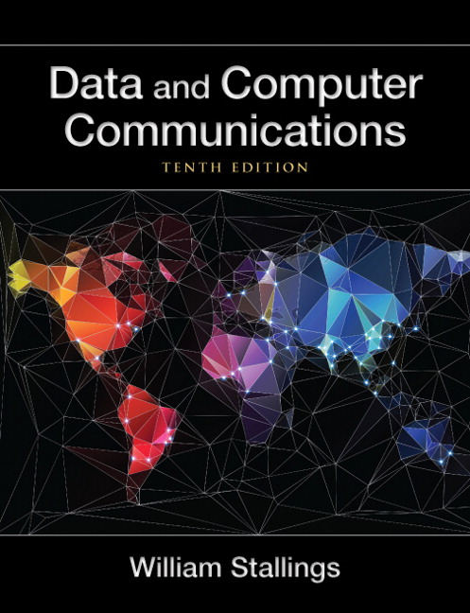
Summary
Transmission terminology
Frequency, spectrum, and bandwidth
Analog and digital data transmission
Analog and digital data
Analog and digital signals
Analog and digital transmission
Asynchronous and synchronous transmission
Transmission impairments
Attenuation
Delay distortion
Noise
Channel capacity
Nyquist bandwidth
Shannon capacity formula
The expression E_{b}/N_{o}
Notes:
Chapter 3 summary.

